Slide 1
Candidate Journey
Visual Walkthrough

Slide 2
This slidedeck contains screenshots of each step a candidate goes through when sitting a Remotely Invigilated exam with TestReach
Before Exam:
Login
Password Reset
Welcome
Check Set Up
  Webcam Check
  Microphone Check
  Speaker Check
  Screenshare Check
Set Up Check Complete
Book Exam Time
Exam Page
Schedule Exam
Exam Day:
Exam Tab
Exam Tab at Time of Exam
Confirm Settings
System Check Passed
Pre Exam Screen
Connect to Supervisor Queue
Connected with a Supervisor
Connected with a Supervisor - Exam Access Granted
In Exam
Exam Submitted Screen
Other Pages
Take Tutorial Tab
Access User Profile
User Profile
Reset Password
Set Time Zone and Language

Slide 3
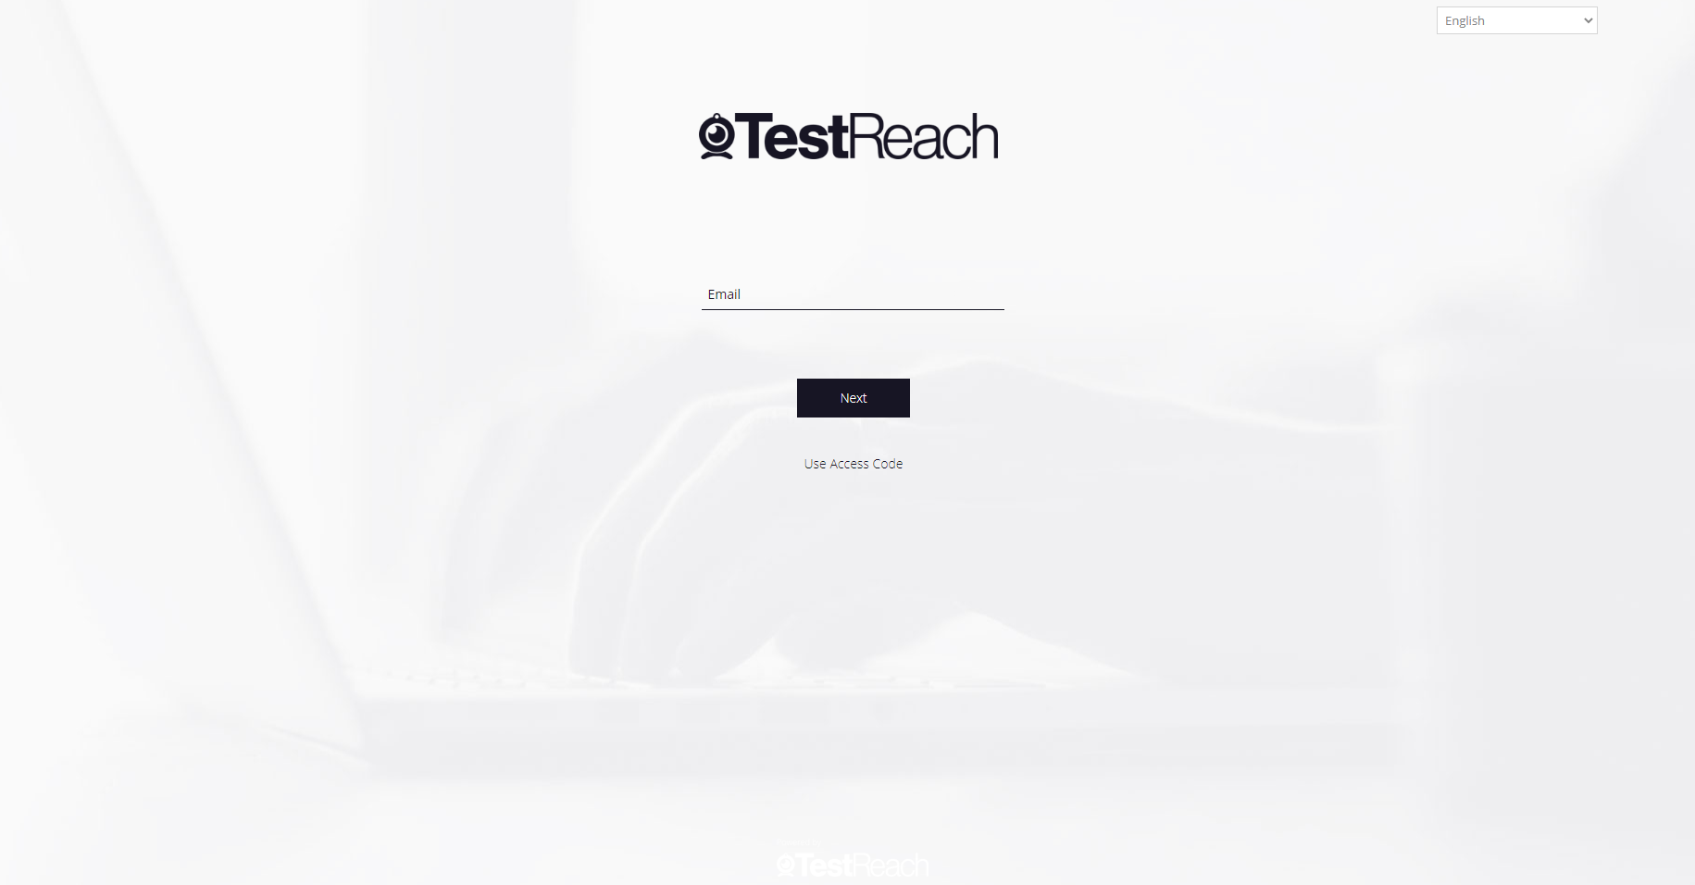
Login Page

Slide 4
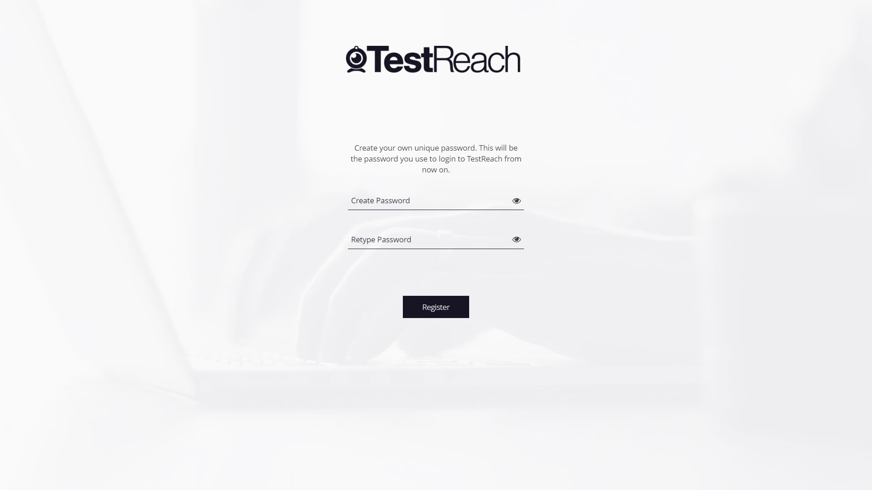
Password Reset Page

Slide 5
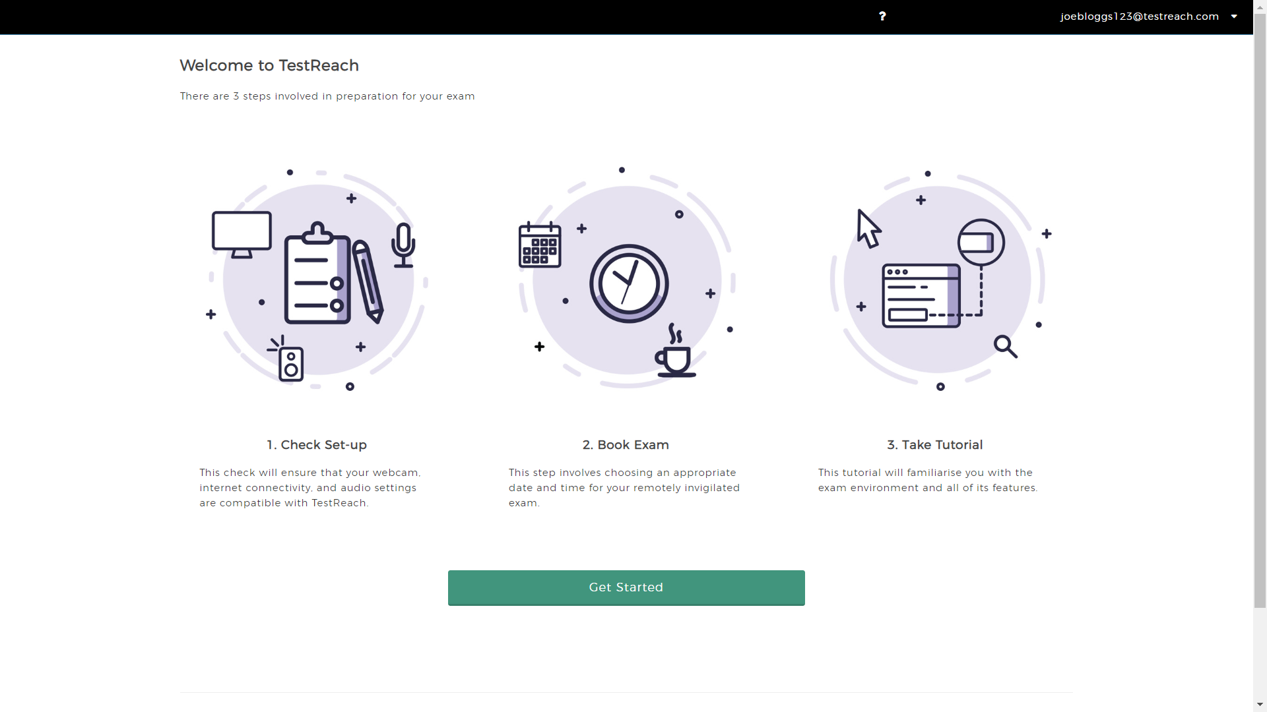
Welcome Page

Slide 6
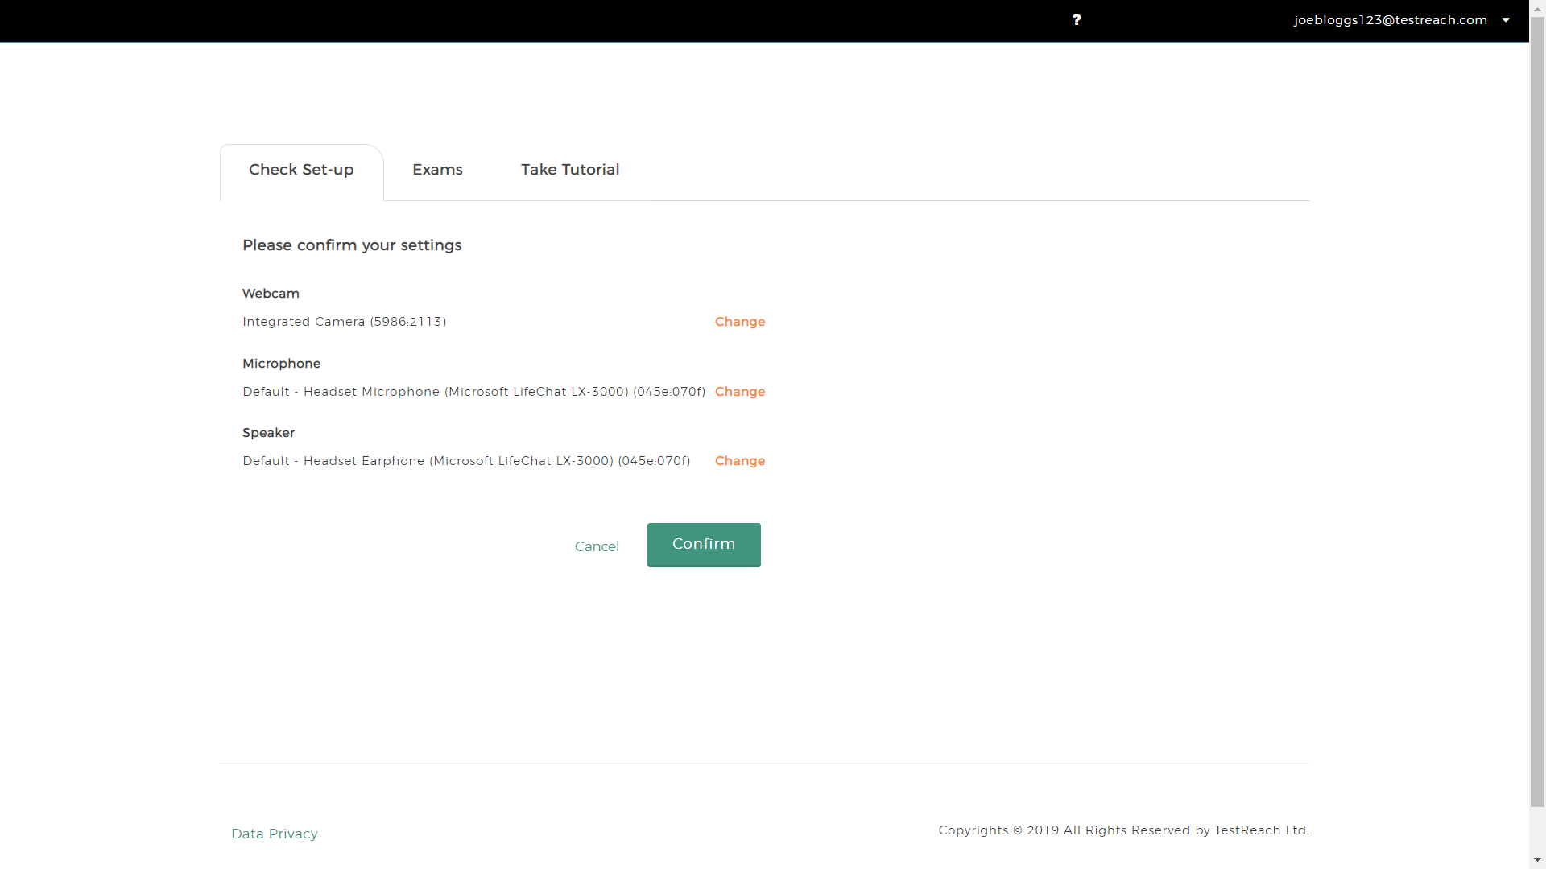
Check Set-Up Page

Slide 7
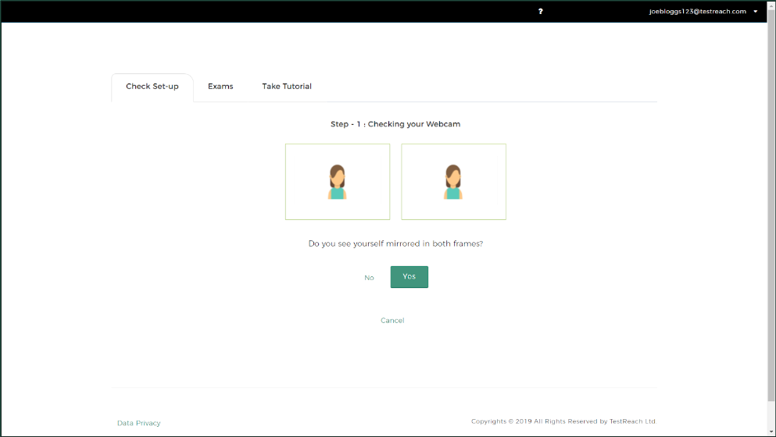

Check Set-Up - Webcam Check

Slide 8
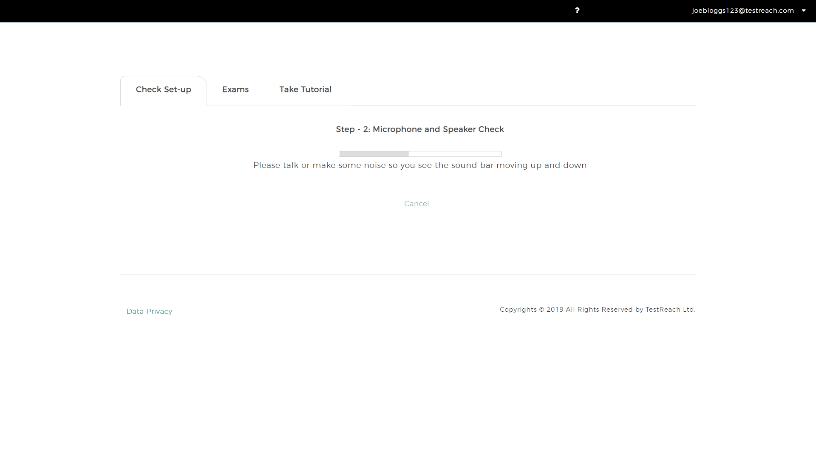
Check Set-Up - Microphone Check

Slide 9
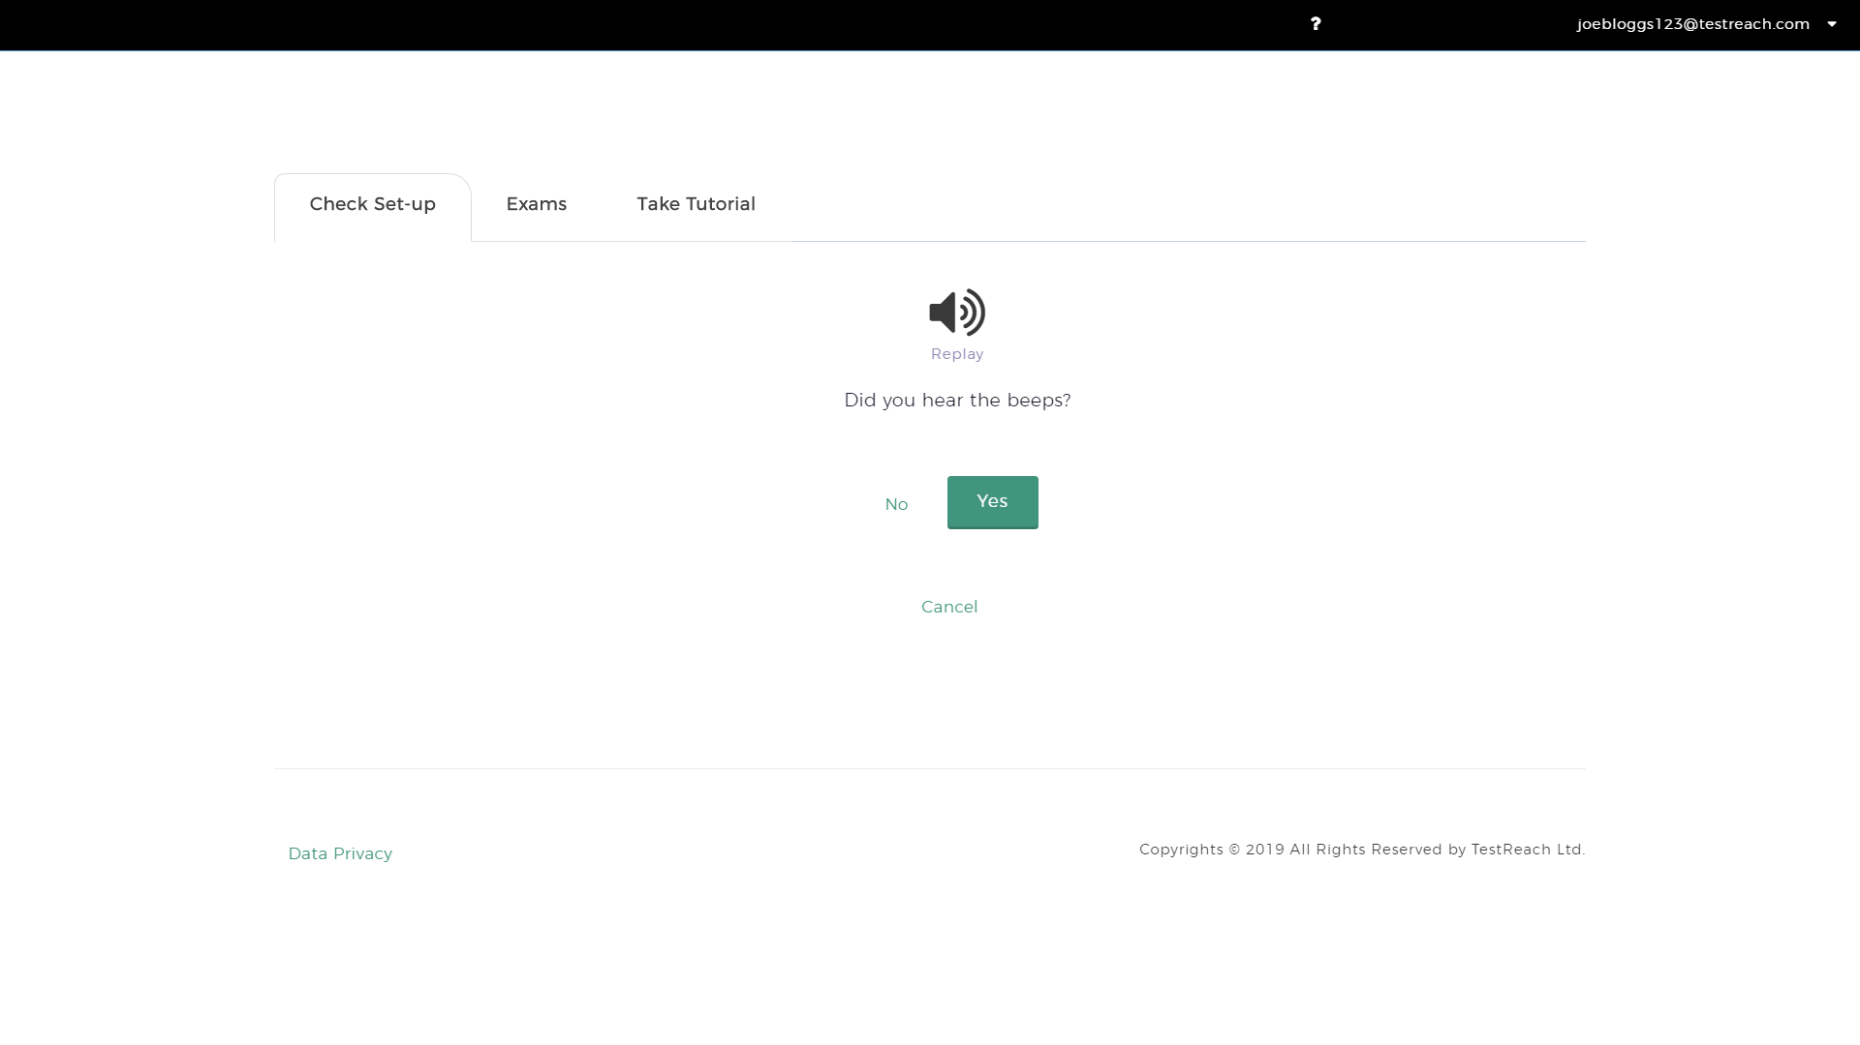
Check Set-Up - Speaker Check

Slide 10
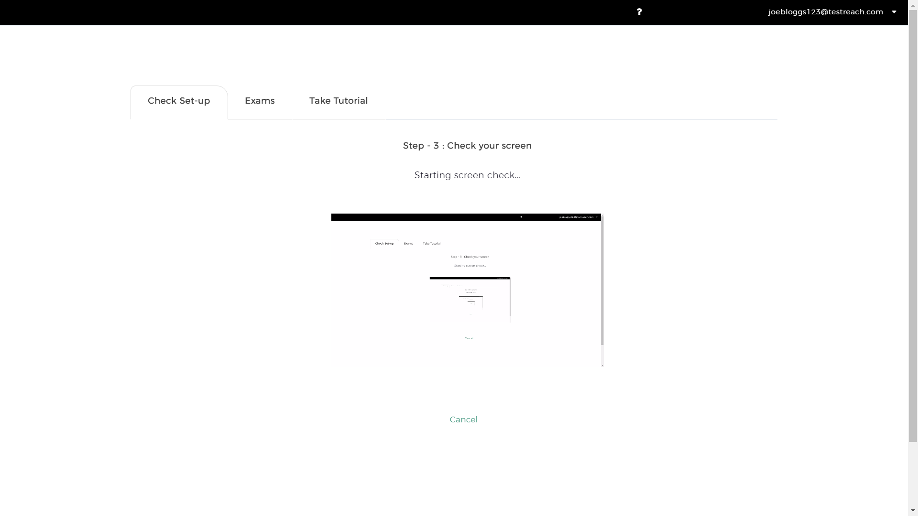
Check Set-Up - Screen Check

Slide 11
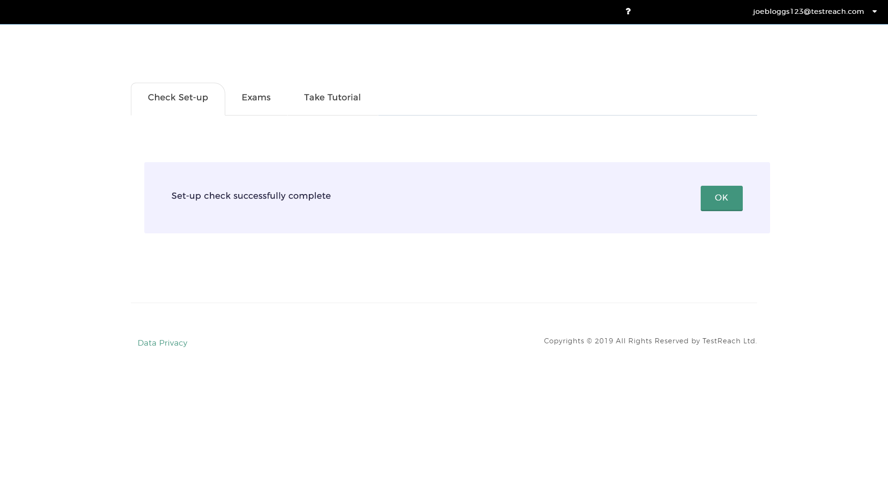
Set-up Check Successfully Complete

Slide 12
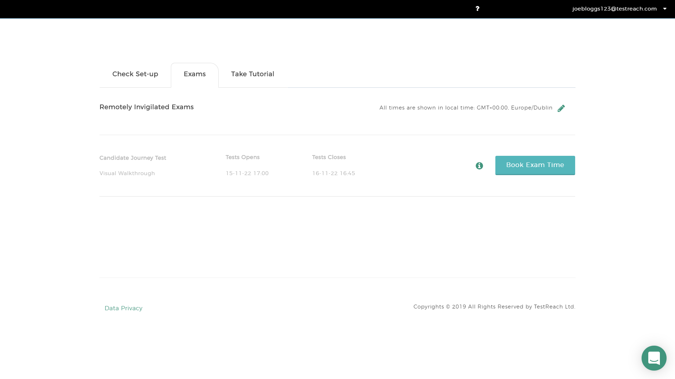
Book Exam Time Page

Slide 13
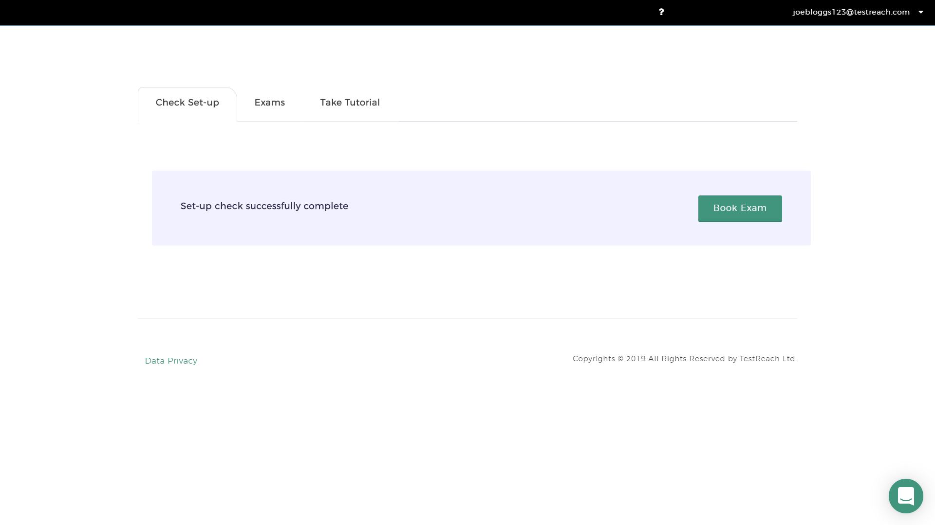
Book Exam Page

Slide 14
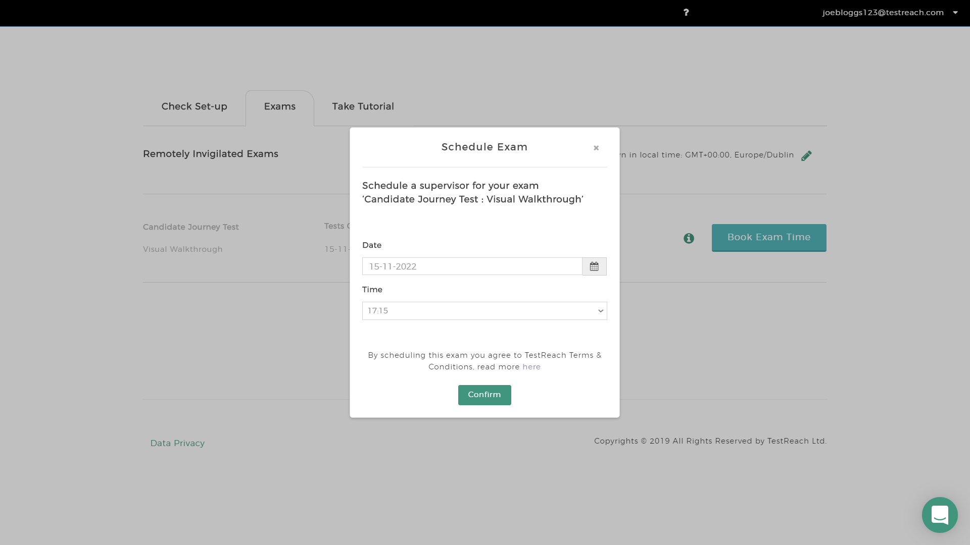
Schedule Exam Screen

Slide 15
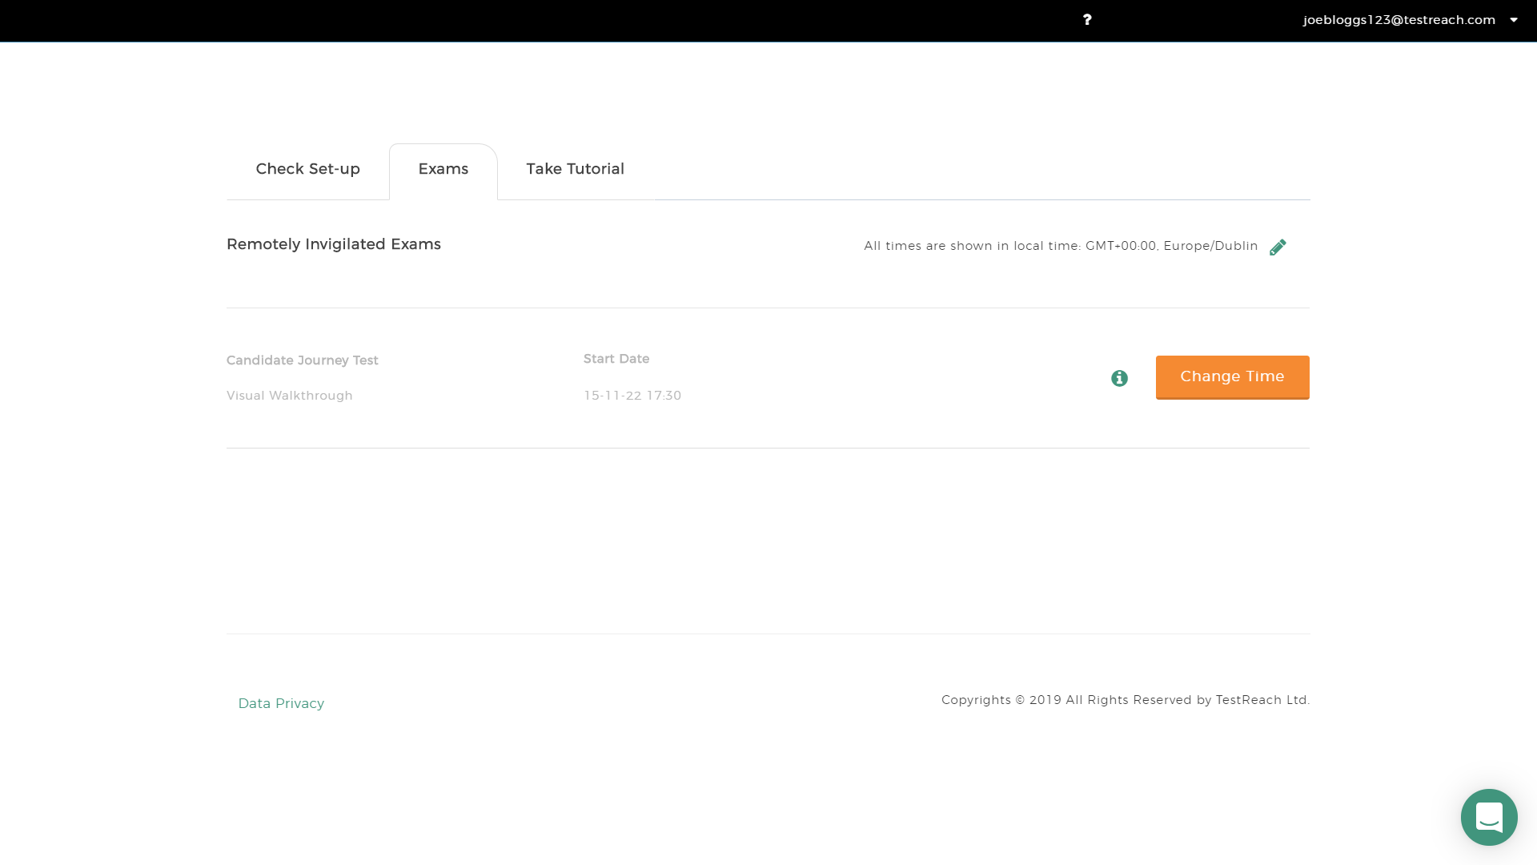
Exam Screen

Slide 16
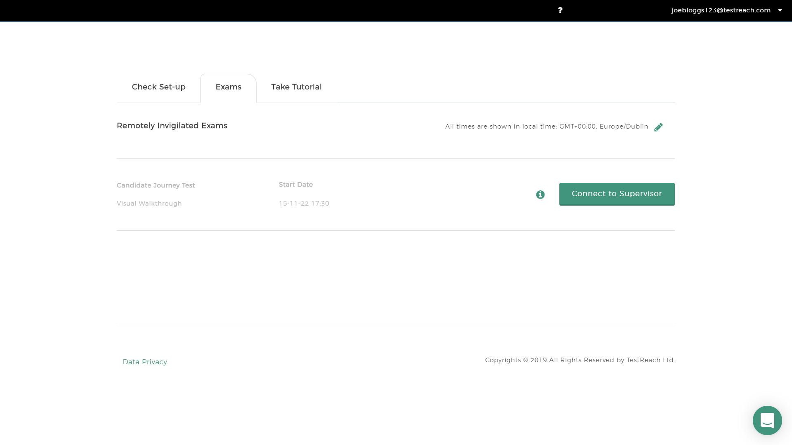
Exam Page at Time of Exam

Slide 17
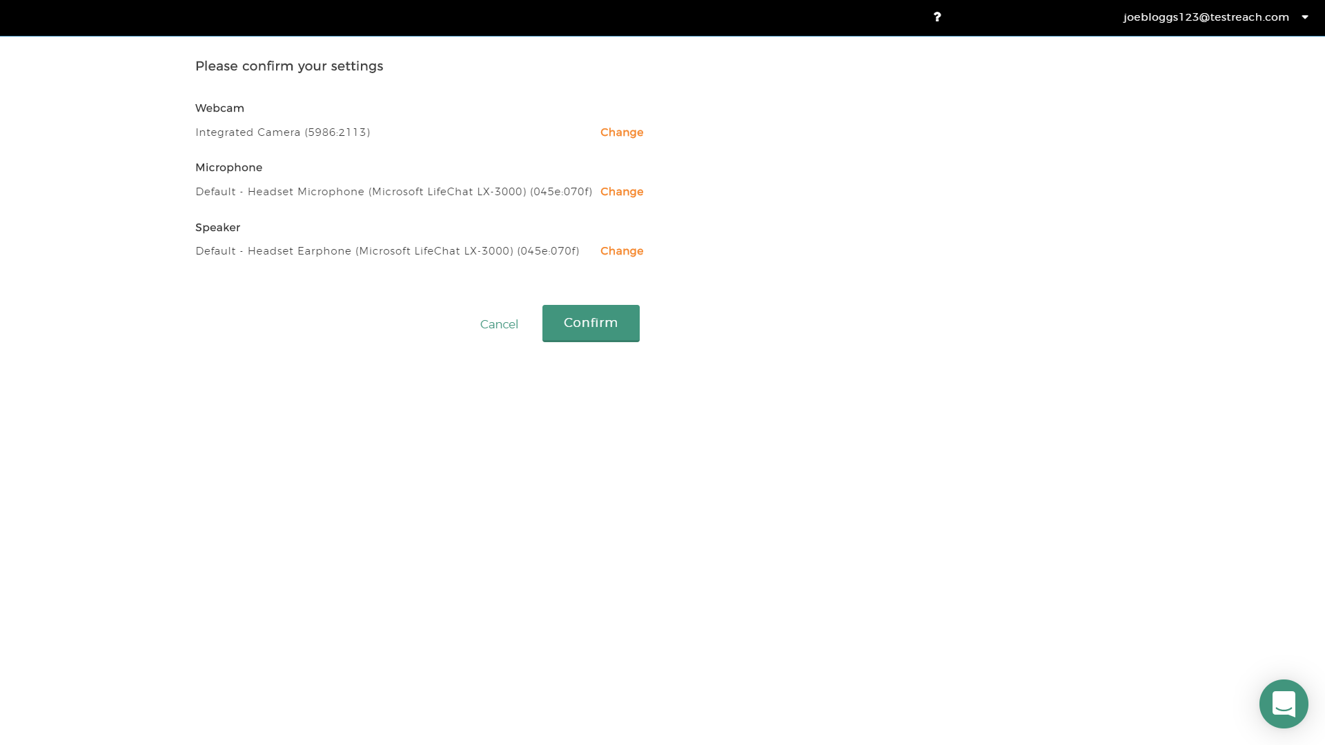
Confirm Settings

Slide 18
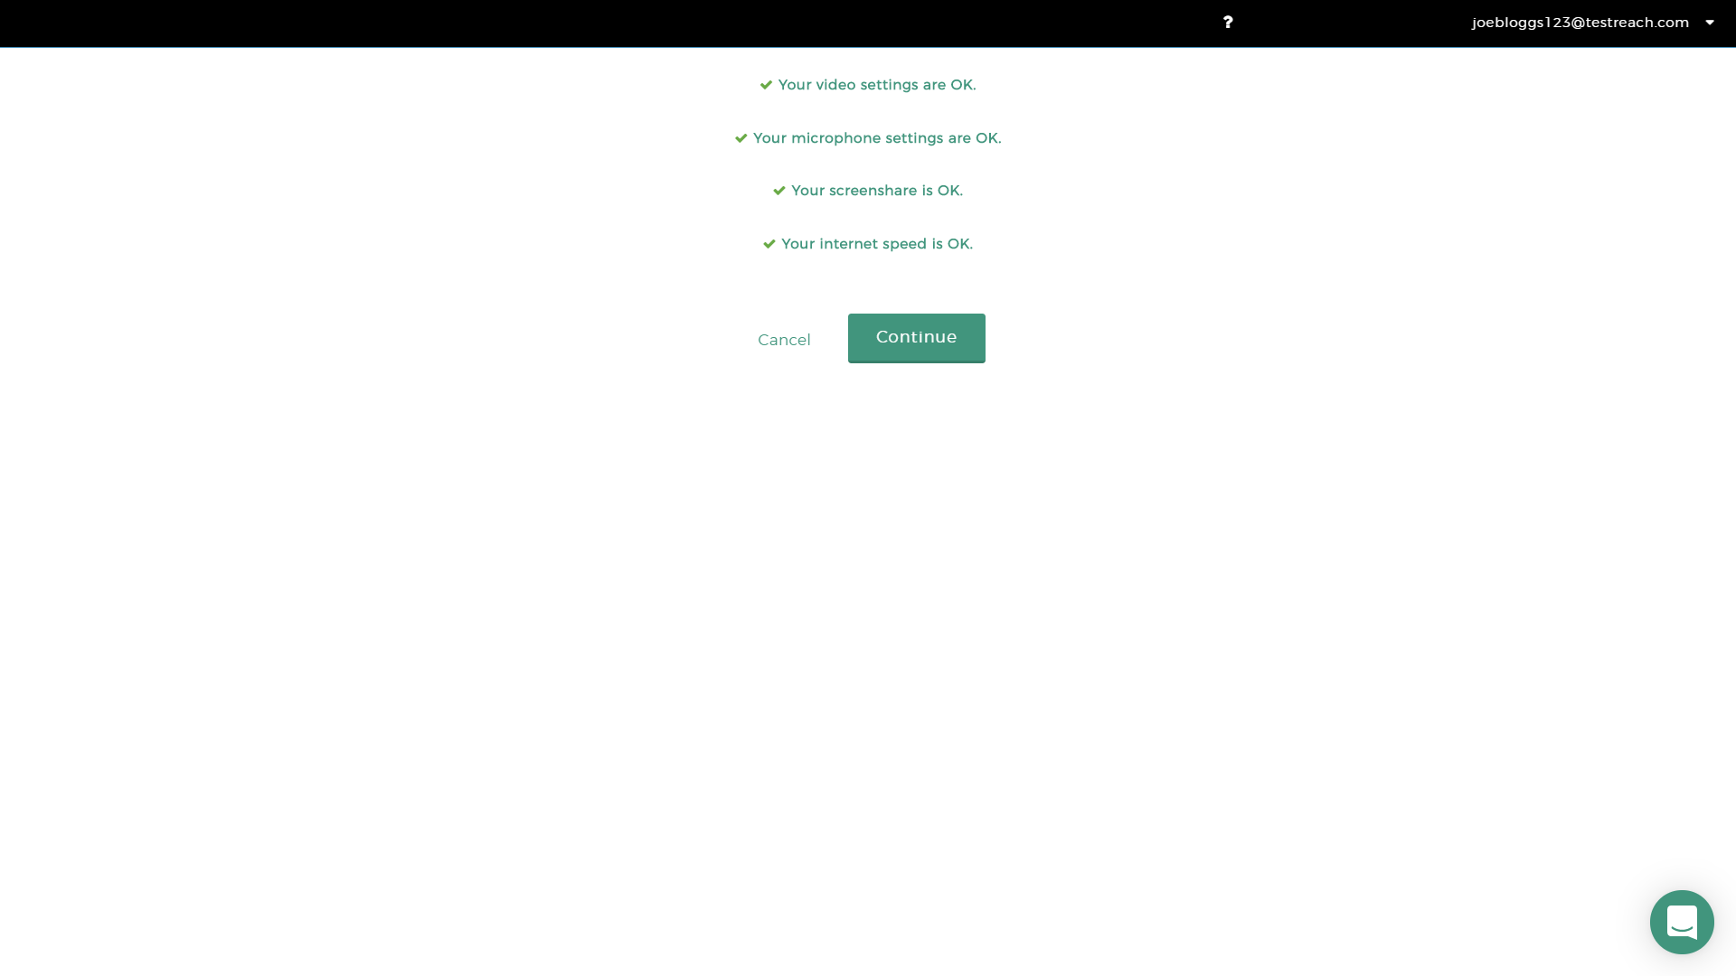
System Check Passed

Slide 19
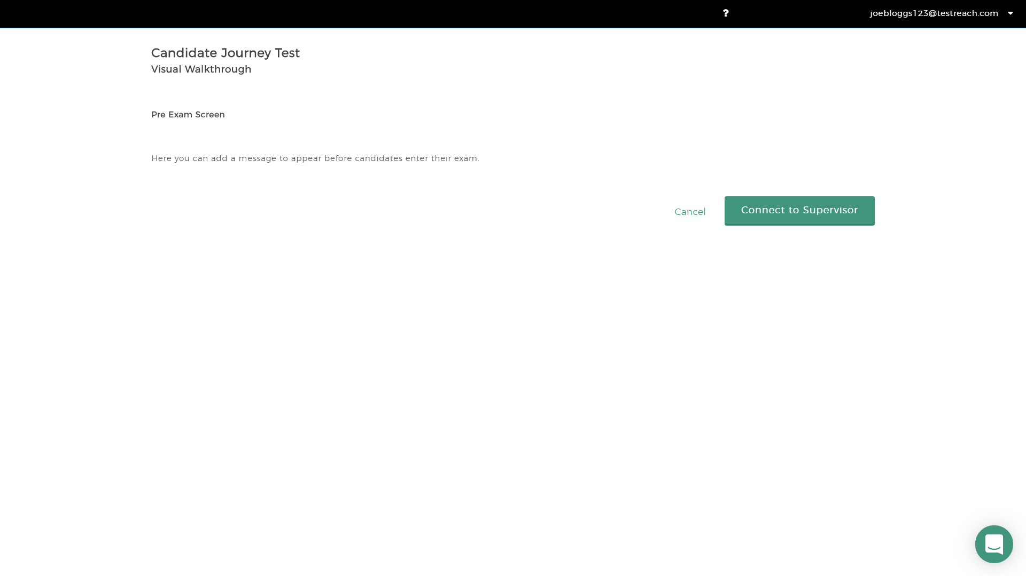
Pre Exam Screen

Slide 20
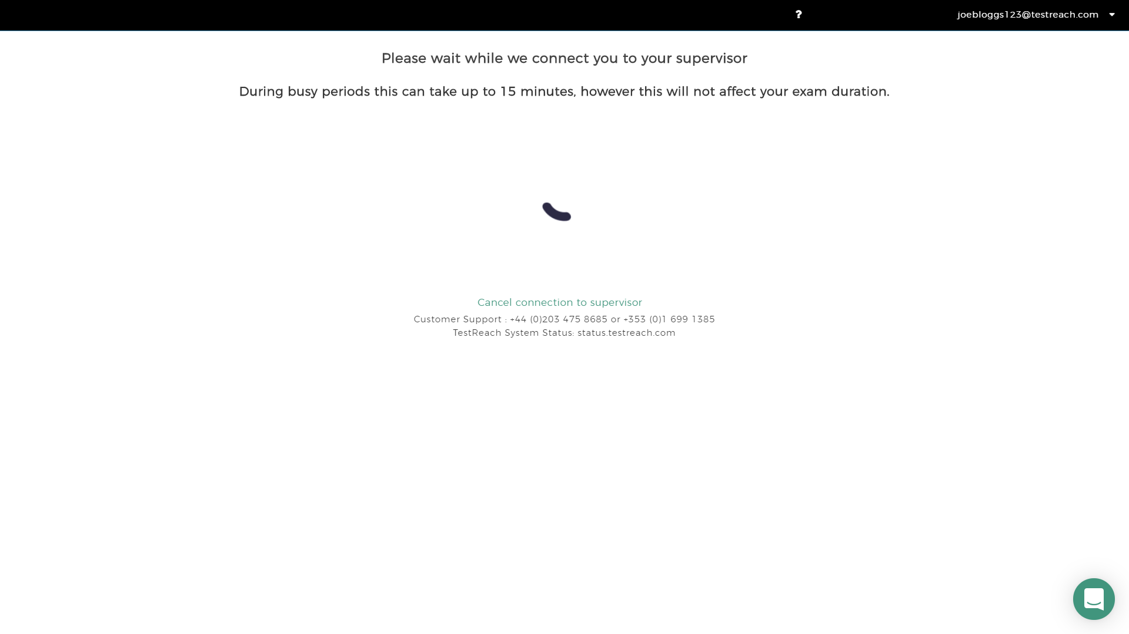
Connect to Supervisor Queue

Slide 21
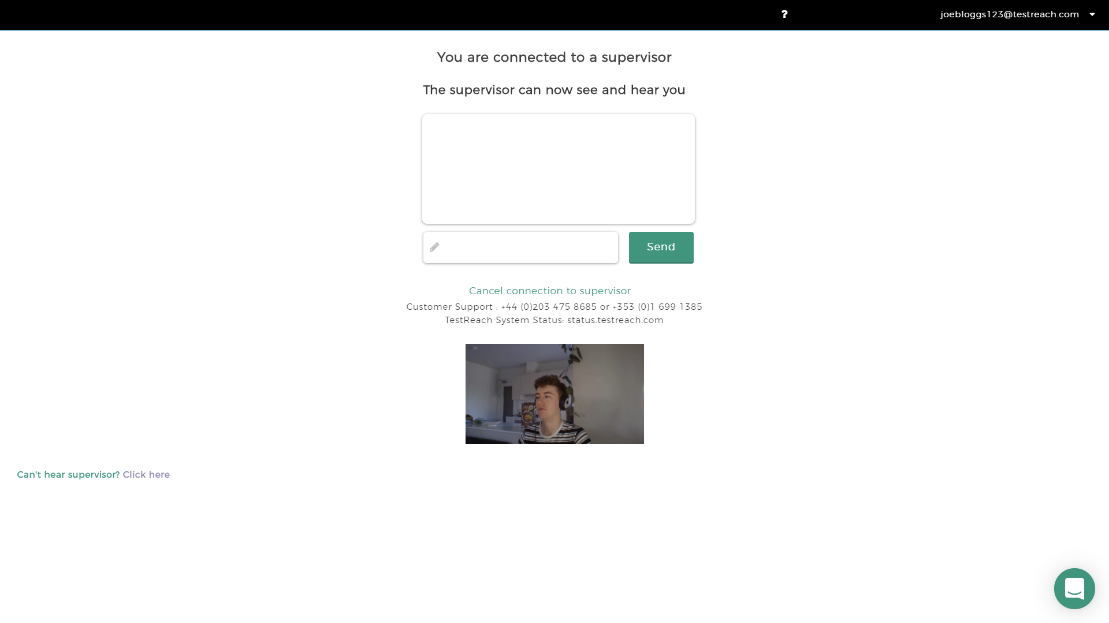
Connected with a Supervisor

Slide 22
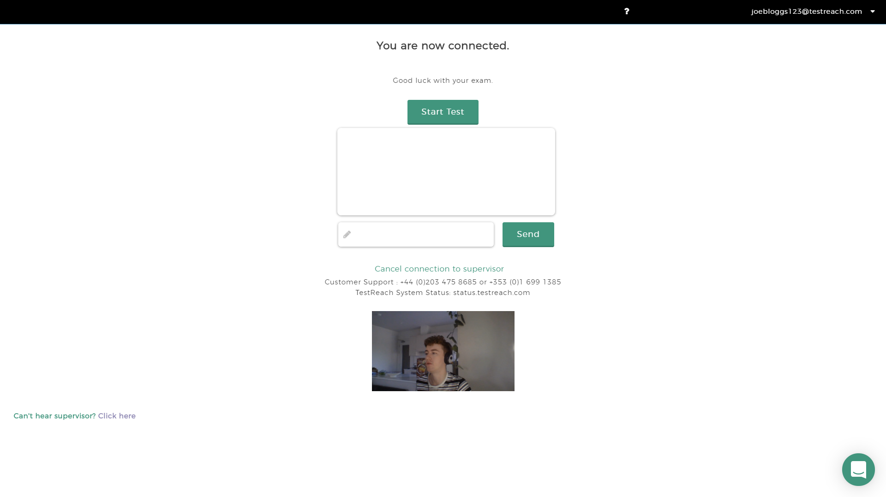
Connected with a Supervisor - Exam Access Granted

Slide 23
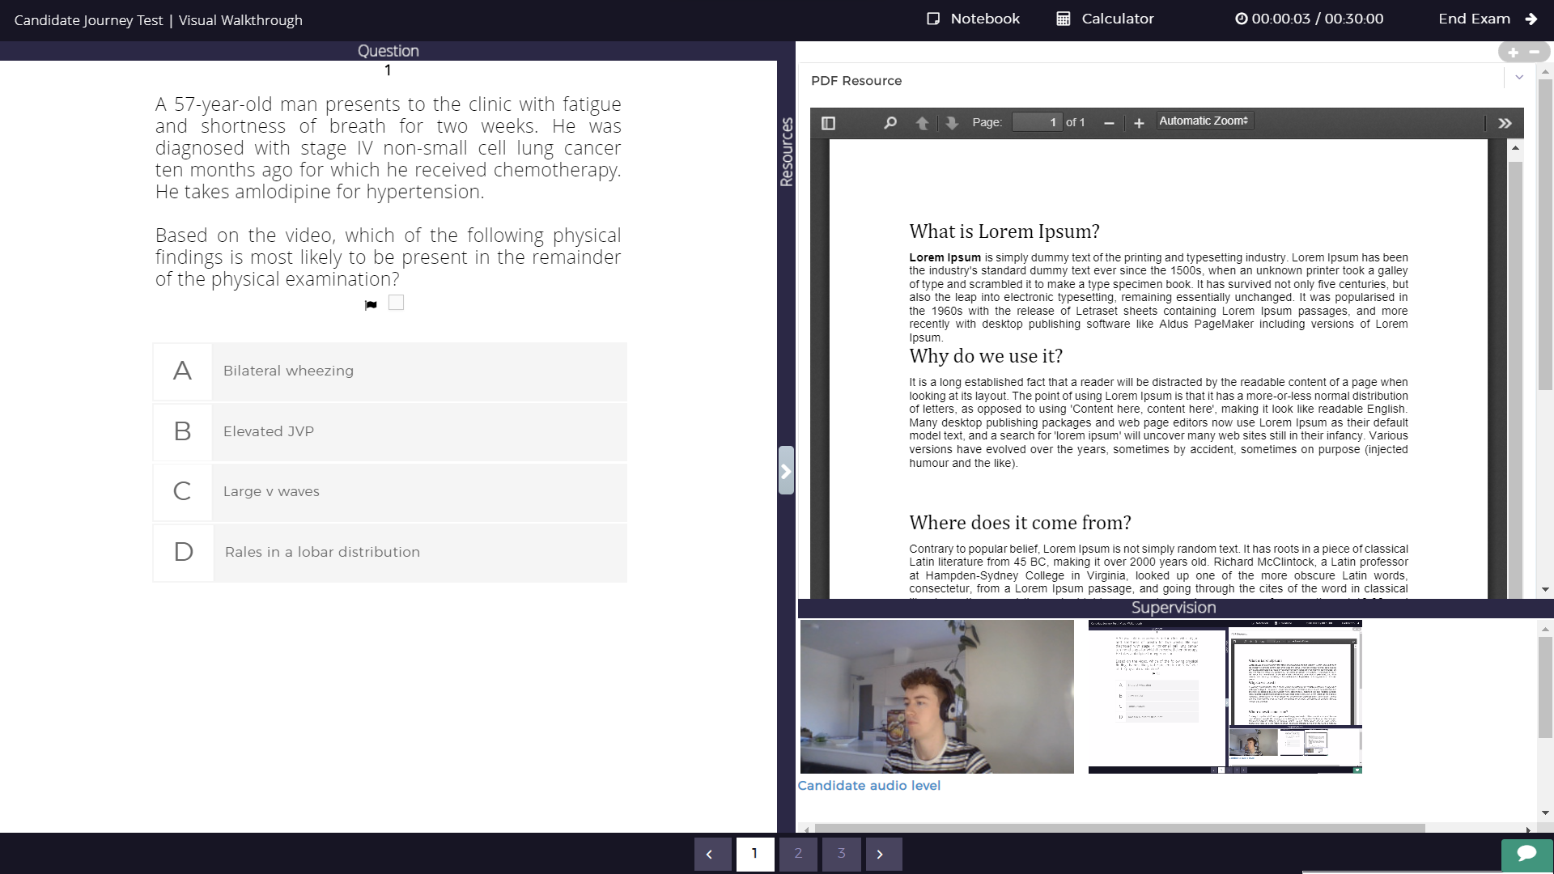
In Exam

Slide 24
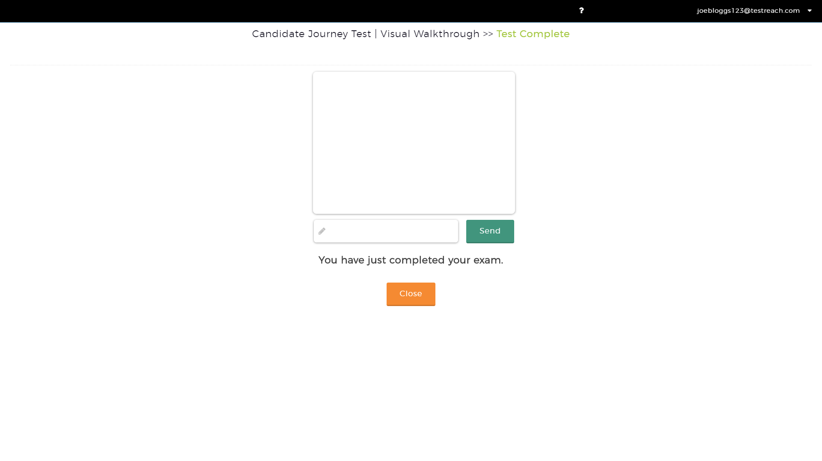
Exam Submitted Screen

Slide 25
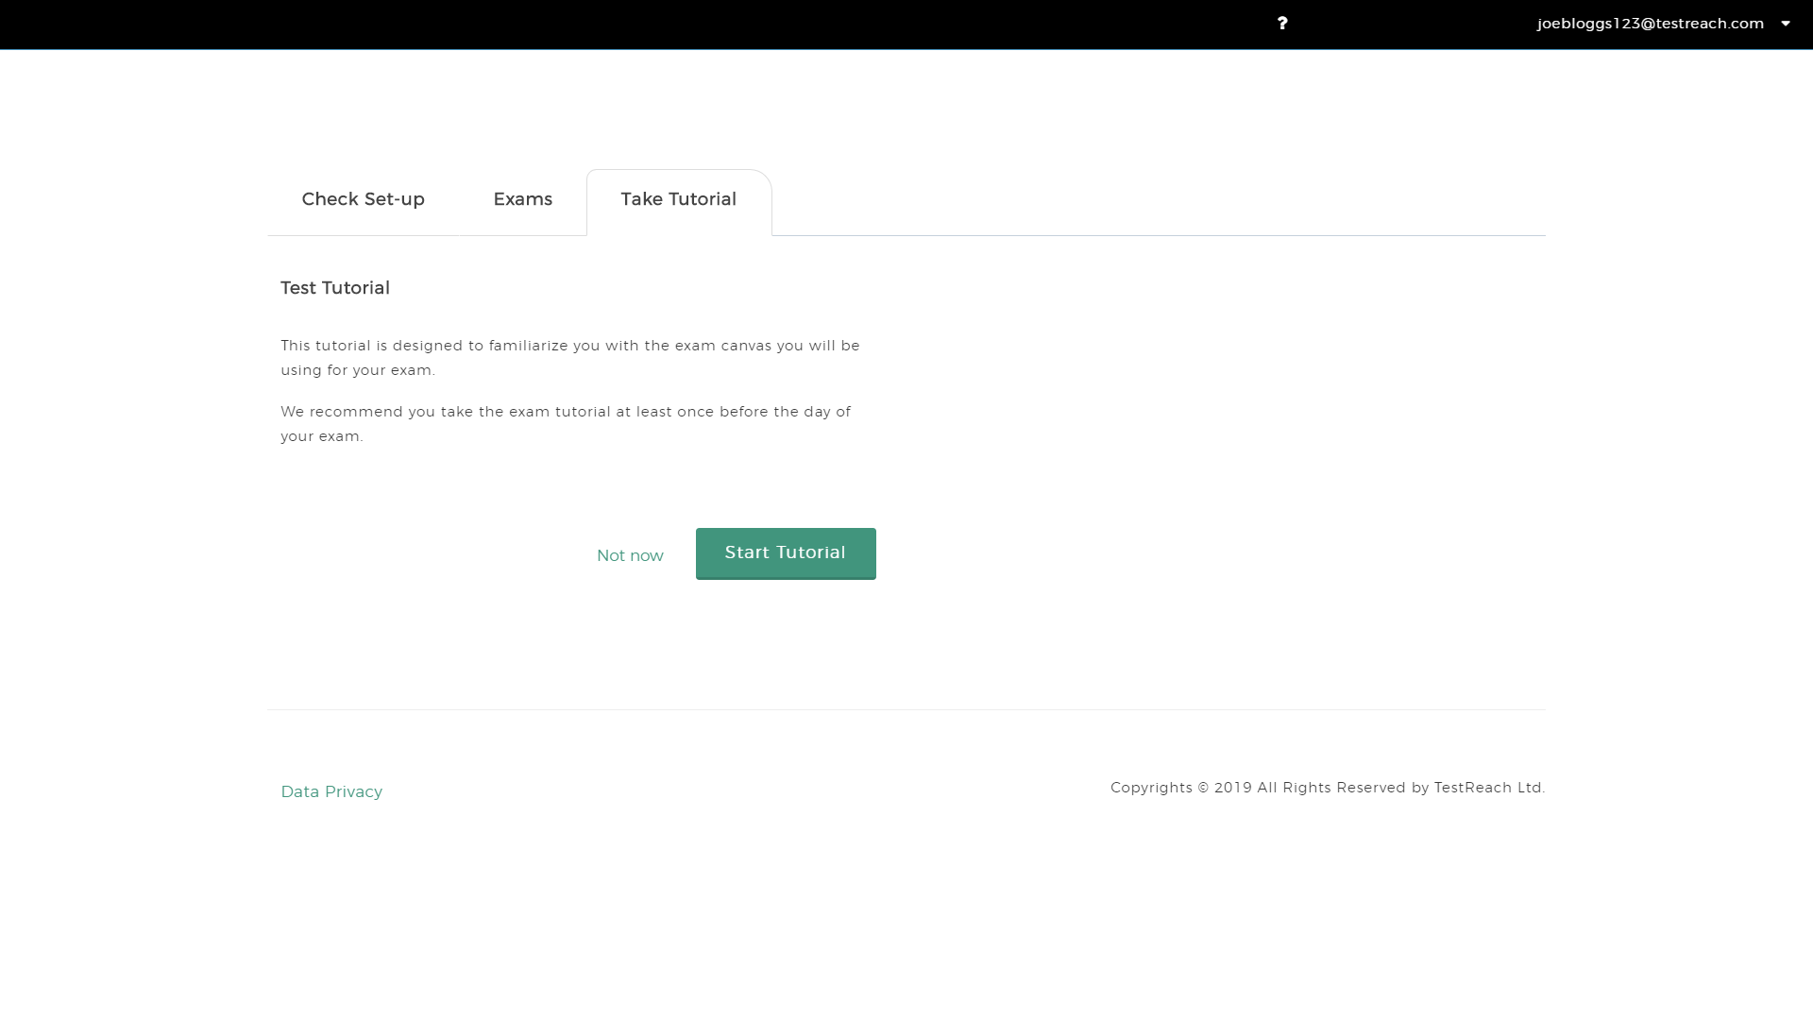
Take Tutorial Tab

Slide 26
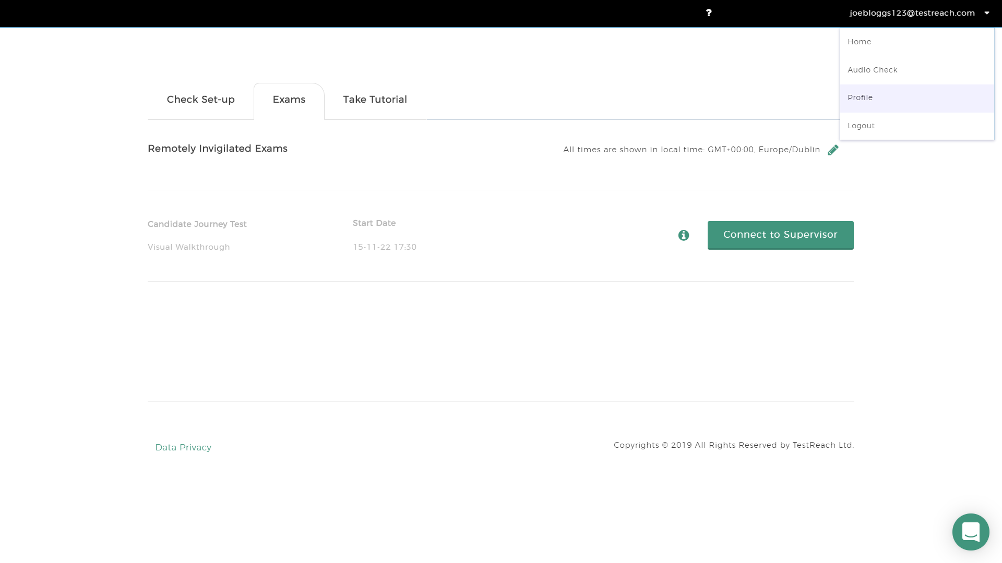
Access User Profile

Slide 27
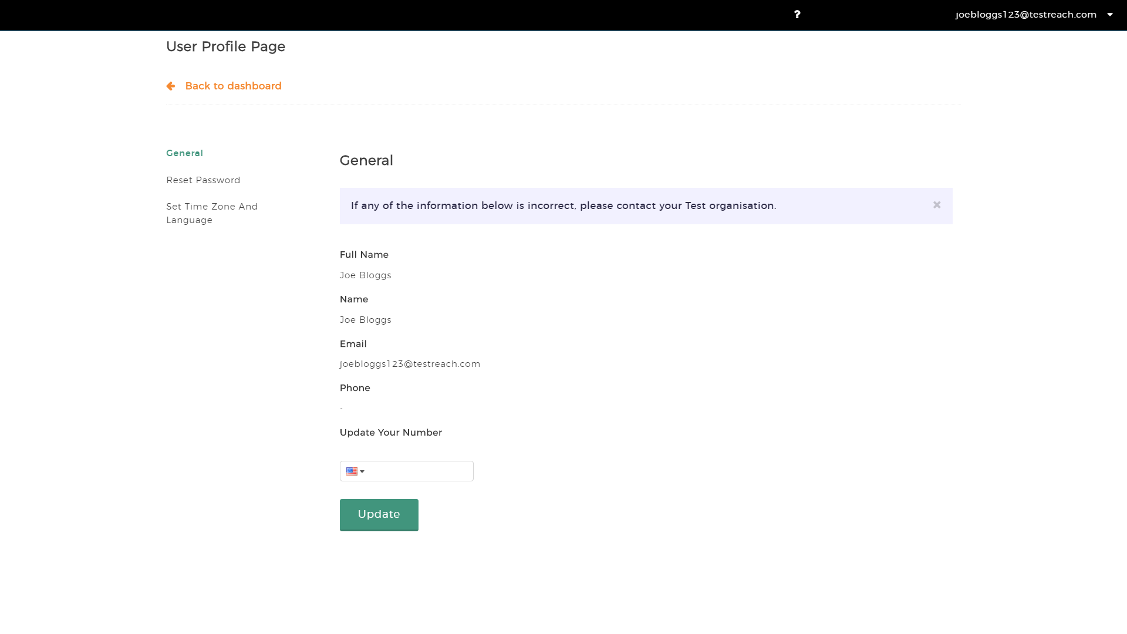
User Profile

Slide 28
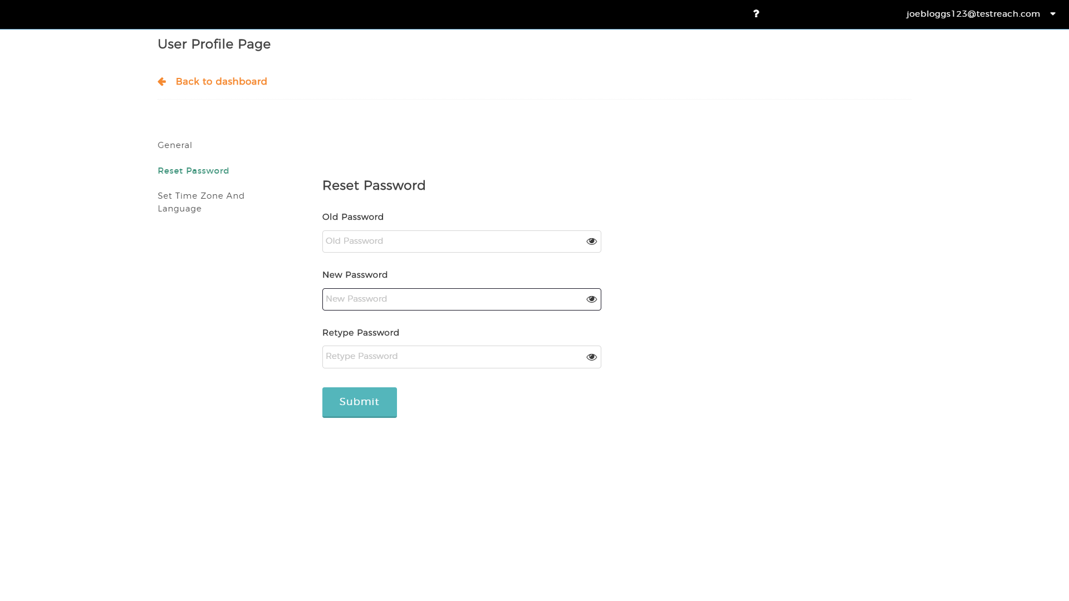
Reset Password

Slide 29
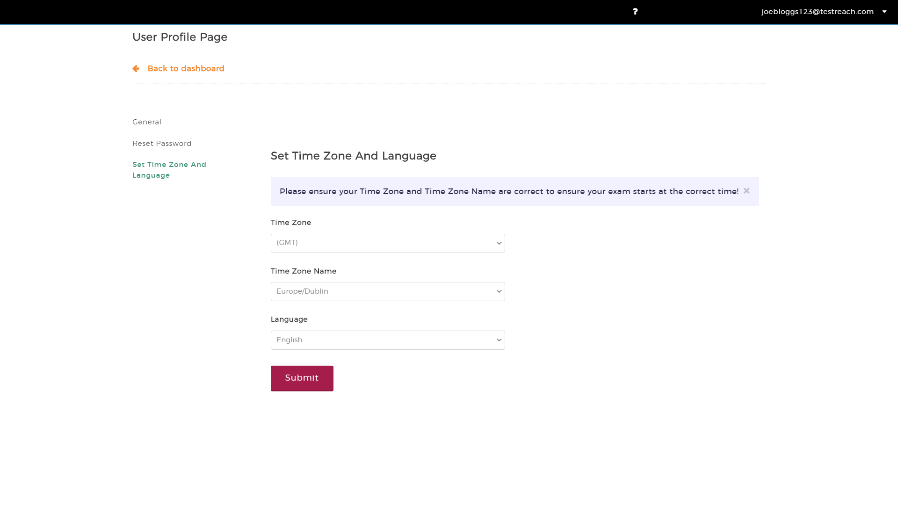
Set Time Zone and Language

